Slide 1
Dustbin Reachability
Report on “Placing Dustbins Where Needed”
Submitted by the Eco Club
Submitted to:
The Principal,
Vasavi College of Engineering
Submitted by:
Eco Club Members –
Mythili K
Indu
Ganesh B
Vivek Varma
Manojkumar
Jeevan
Date : 25 October 2025

Slide 2
INTRODUCTION
Clean surroundings reflect the discipline and environmental awareness of an institution. The Eco Club of our college identified several areas within the campus that lacked proper waste disposal facilities. In order to promote cleanliness and sustainability, the club initiated a project to place dustbins in required locations.

Slide 3
OBJECTIVES
To maintain cleanliness and hygiene on the campus.
To encourage students and staff to dispose of waste properly.
To reduce littering and promote environmental responsibility.
To support the college’s “Clean and Green Campus” mission.

Slide 4
IMPLEMENTATION
The Eco Club conducted a survey around the campus to identify areas where dustbins were needed. After submitting a request to the management, the college administration approved the placement of dustbins in those locations.
With their support, multiple dustbins of different colors were installed for segregated waste disposal — biodegradable, non-biodegradable, and recyclable waste.

Slide 5
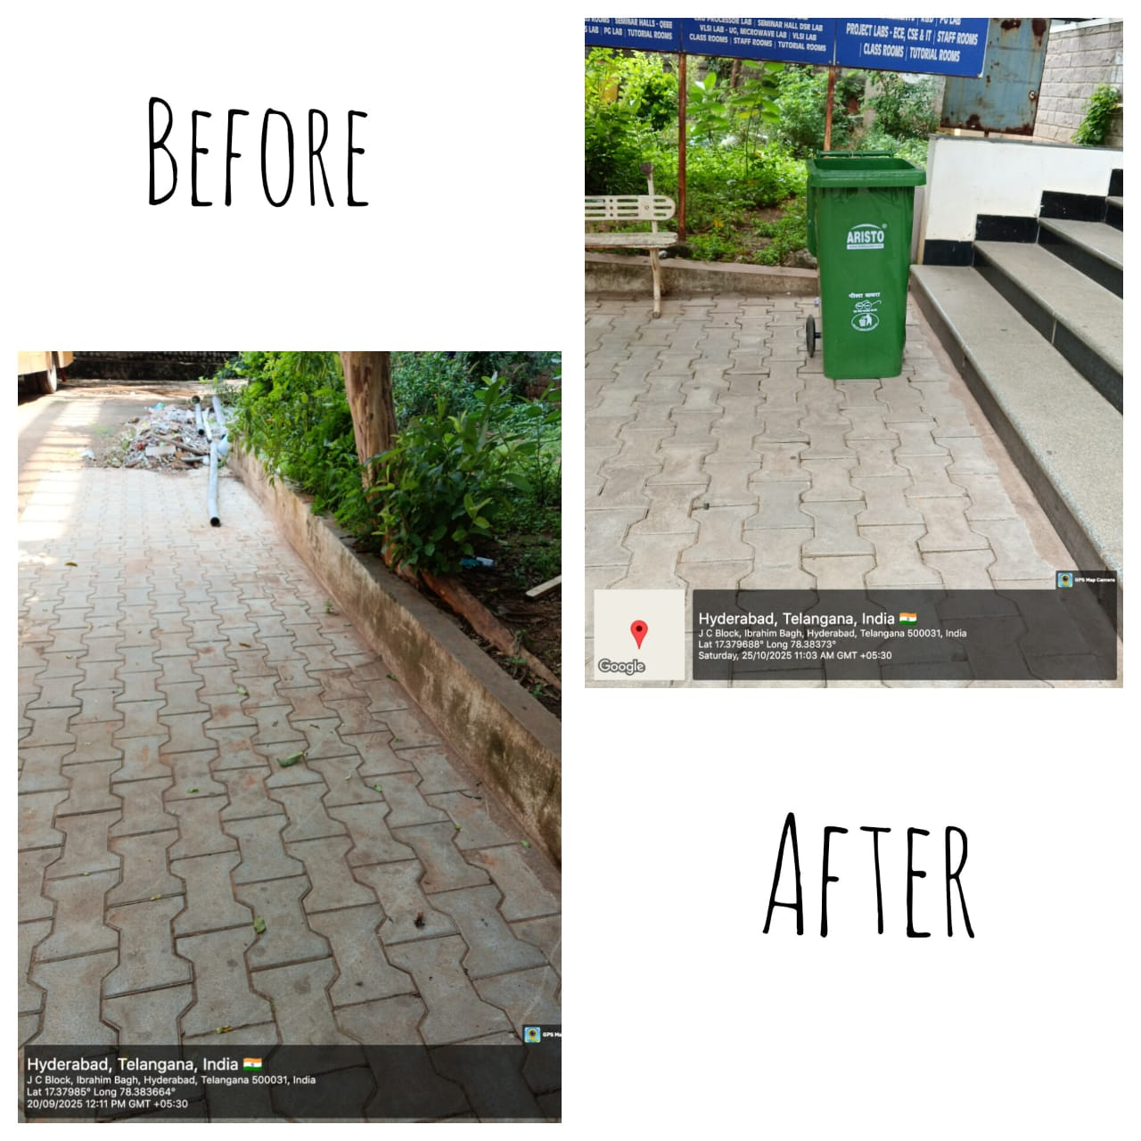
Beside JC Bose Block

Slide 6
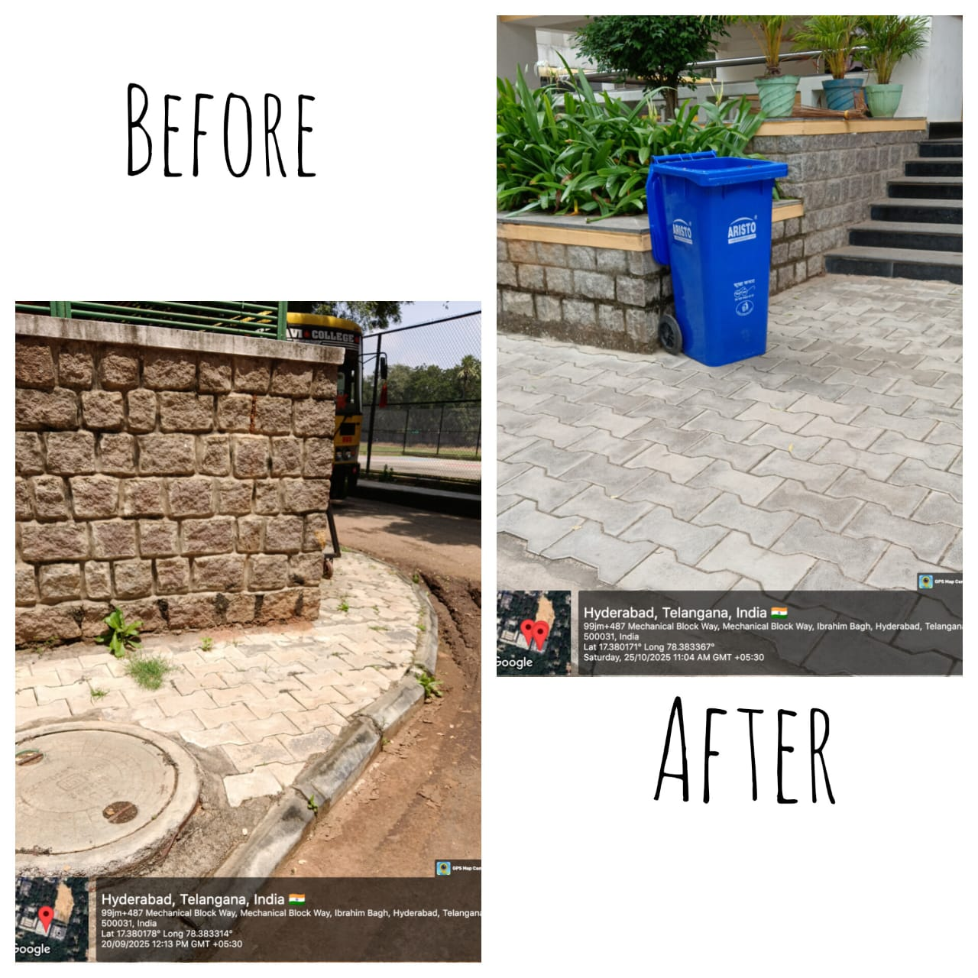
Infront of VS Block

Slide 7
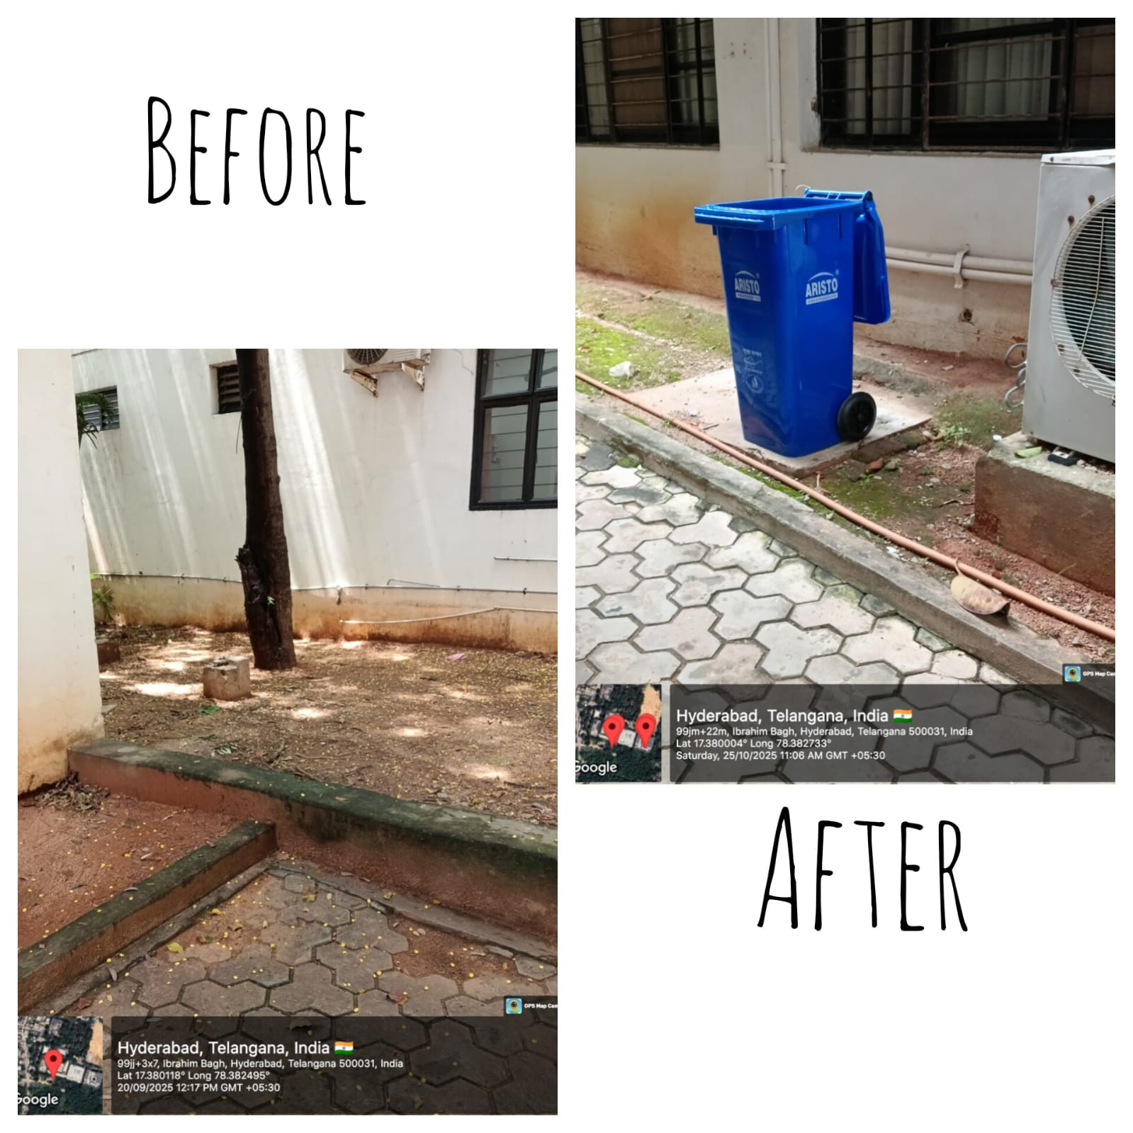
Beside CV Raman Block

Slide 8
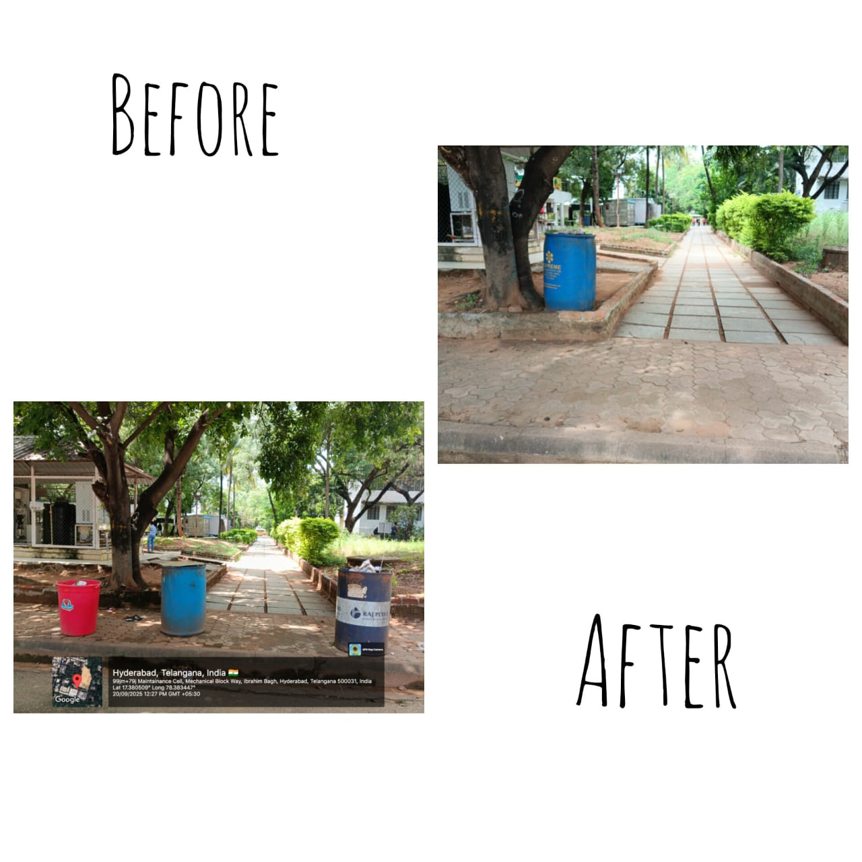
Too many dustbins were placed here they were causing bad smell

Slide 9
Result and Observation
4. Results and Observations
Before Installation: Certain areas of the campus, such as pathways and corners near blocks, lacked dustbins. As a result, students and visitors often had difficulty finding proper waste disposal points, leading to scattered litter
After Installation:The management promptly placed dustbins in all the identified locations. This has significantly improved the cleanliness and appearance of the campus. Students have also become more conscious about maintaining hygiene.
Visual Evidence:Below are a few “Before and After” photographs.
Pathway near Academic Block
Area beside Mechanical Block3. Corridor beside JC BlockThese images clearly illustrate After Installation:
The management promptly placed dustbins in all the identified locations. This has significantly improved the cleanliness and appearanceof the campus. Students have also become more conscious about maintaining hygiene.
Visual Evidence:
Below are a few “Before and After” photographs taken from the project sites
1. Pathway near Academic Block
2. Area beside Mechanical Block
3. Corridor beside JC Block
These images clearly illustrate the positive transformation achieved through the initiative.

Slide 10
Conclusion
The project successfully addressed one of the primary issues related to campus cleanliness. The combined effort of the Eco Club and college management has resulted in a cleaner and more organized environment. Continued awareness among students will ensure the long-term success of this initiative.

Slide 11
Acknowledgement
We extend our sincere gratitude to our Principal for the encouragement and support, and to the college management for promptly installing the dustbins in the required areas. We also thank all Eco Club members for their active participation in this meaningful project.

